Slide 1
Comparative Study of Smart Lighting Grids with LEDs Operated with Concentrated, Localized or Distributed Control
2012 International Symposium on Power Electronics, Electrical Drives, Automation and Motion
Authors : A. Suzdalenko*, I. Milashevski**, I. Galkin***
*Riga Technical University, doctoral student (Latvia)
** Tallinn University of Technology, doctoral student(Estonia)
*** Riga Technical University, professor (Latvia)

Slide 2
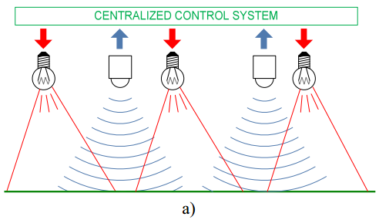
Centralized
With the centralized approach, data acquisition and control functions are concentrated in one unit that acquires information from sensors, makes decision and drives sources of light.

Slide 3
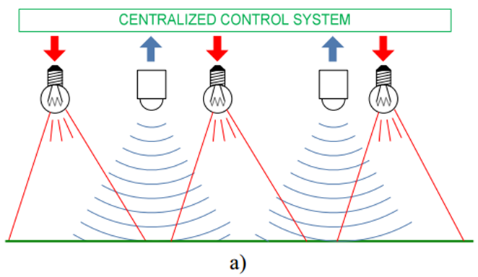
Its fault leads to a global malfunction of the entire lighting grid.
This system is also not friendly for further expansion.
More productive control unit allows realization of more sophisticated control functions as well as better communication with higher level control equipment.
Matrix of sensors can be arbitrary configured.

Slide 4
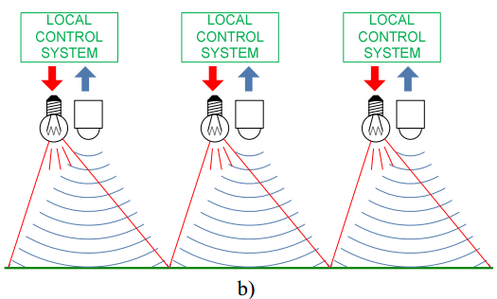
Localized
The next approach assumes that data gathering and control functions for a local part of the object are concentrated in the part and communicates only with dedicated sensors and sources of light.

Slide 5
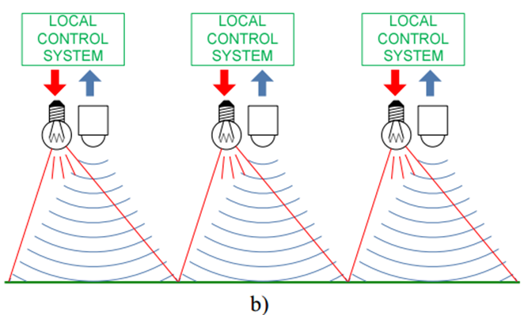
Globally leads to correspondence of sensor matrix and matrix of light sources.
Control units are simpler and control functions are also limited.
Faults are critical only for the corresponding part of the object.
Can be easily expanded.

Slide 6
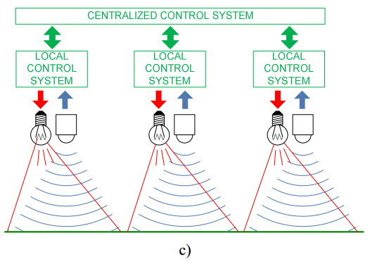
Localized with supervision
Control functionality of such system can be improved through applying of a supervisory unit of higher level (of course, at the cost of lower expandability). This configuration can be regarded as a safer version of the centralized control system.

Slide 7
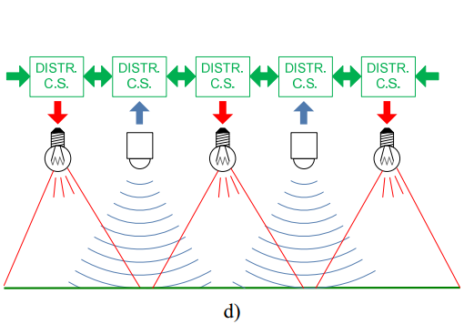
Distributed
The approach proposed in this paper assumes that the control functions for a local part of the object are distributed between the given part and closer or further neighbor parts of the object.

Slide 8

The system is equally expandable and safe.
The functionality depends on the data throughput of the communication between the distributed control parts.
Sensor matrix and matrix of light sources may not correspond.

Slide 9
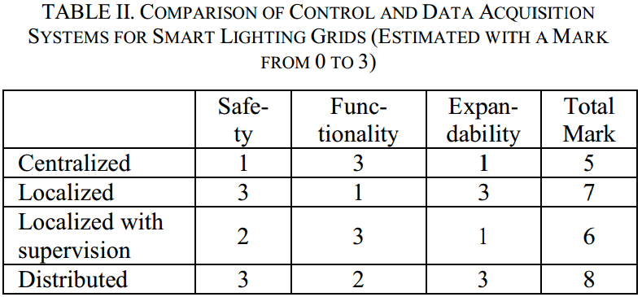
Summarized

Slide 10
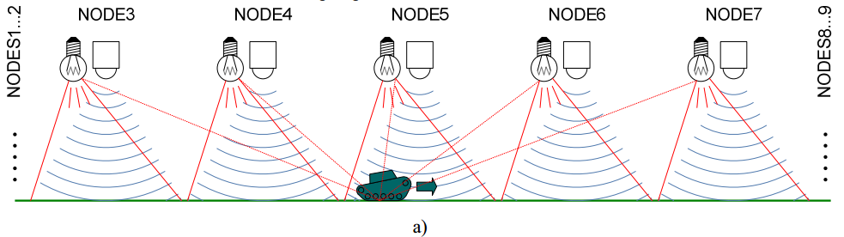
A physical model of smart lighting grid

Slide 11

An object (mobile robot with an IR diode) is moving across the internal 5 LEDs with a constant speed 0.5m/s. The desired illuminance within this track is 30lx.
The lamp at full power provides illuminance of about 60lx in the dark room from a distance 1m.

Slide 12
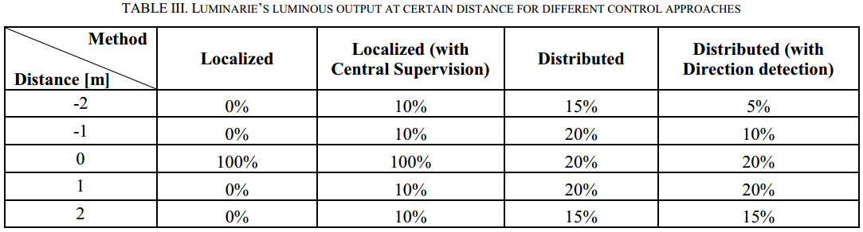
Theoretical illumination level for different control approaches

Slide 13
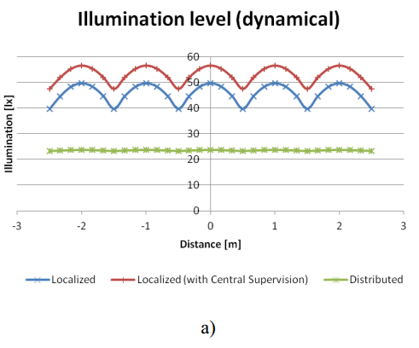
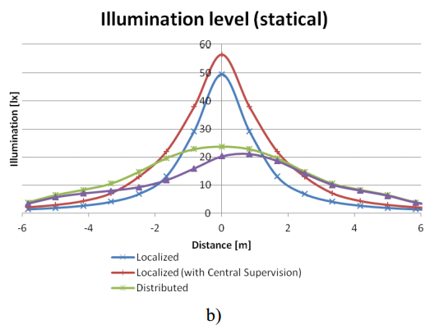

Slide 14
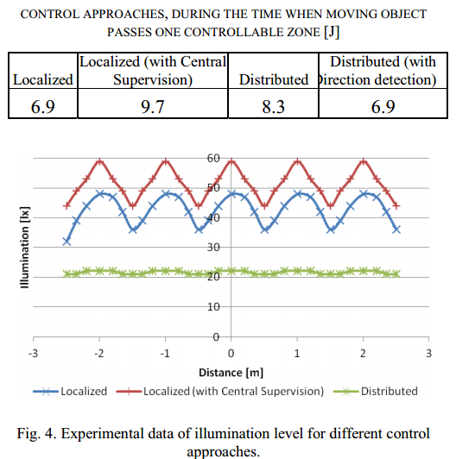
Experimental results

Slide 15
INTELLIGENT LIGHTING CONTROL USING CORRELATION
COEFFICIENT BETWEEN LUMINANCE AND ILLUMINANCE
Mitsunori Miki, Department of Knowledge Engineering, Doshisha University, Kyoto Japan, email: mmiki@mail.doshisha.ac.jp
Tomoyuki Hiroyasu, Department of Knowledge Engineering, Doshisha University, Kyoto Japan, email: tomo@is.doshisha.ac.jp
Kazuhiro Imazato and Motoi Yonezawa, Graduate School of Engineering, Doshisha University, Kyoto Japan, email: kimazato@mikilab.doshisha.ac.jp

Slide 16
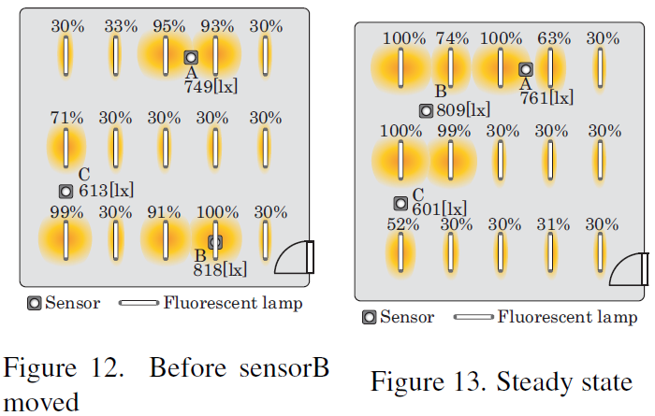

Slide 17
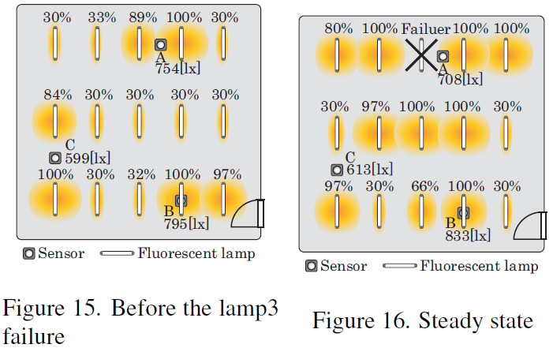

Slide 18
Reference
Light-emitting diode
Fluorescent lamp
INTELLIGENT LIGHTING CONTROL USING CORRELATION COEFFICIENT BETWEEN LUMINANCE AND ILLUMINANCE

